Slide 1
Enhanced Entity-Relationship Modeling
ISYS 464

Slide 2
Supertypes and Subtypes
Supertype: An entity type that includes one or more distinct subgroups which require to be represented in a data model.
Subtype: A subgrouping of the entities in an entity type that has attributes distinct from those in other subgroupings

Slide 3
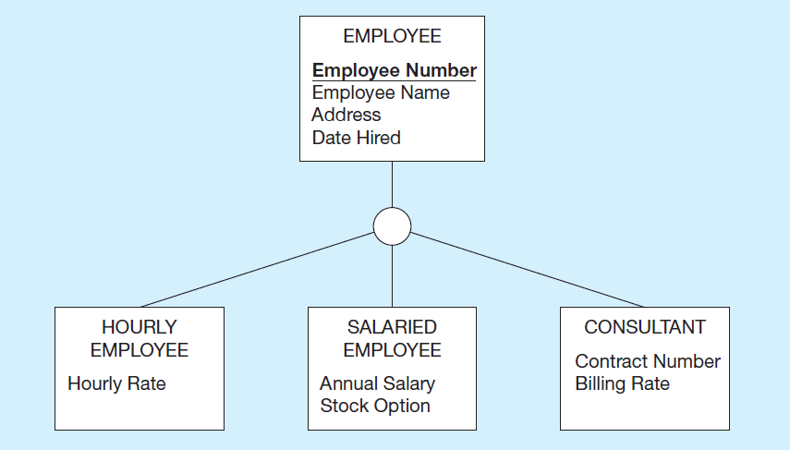
Figure 3-2 Employee Supertype with Three Subtypes
All employee subtypes will inherit employee number, name, address, and date hired. Each employee subtype will also have its own attributes
Notes:
It makes sense to model supertypes and subtypes if certain attributes or relationships apply only to a subset of the total entity type whereas others are shared across the entire entity type. In this case, all employees have names, addresses, and hire dates. But only hourly employees have hourly rates, only salaried employees have salaries and stock options, and only consultants have contract numbers and billing rates. If we simply had an employee entity, then these special-purpose attributes would be irrelevant for many of the employees.

Slide 4
Faculty: Assuming we have three types of faculty
Professor: HighestDegreeEarned
Lecturer: ProfessionalExperience
GraduateAssistant: Major

Slide 5
Attribute Inheritance
Subtype entities inherit values of all attributes of the supertype
An instance of a subtype is also an instance of the supertype
Example:
An hourly employee is also an employee with attributes: Employee Number, Employee Name, Address, Date Hired, and Hourly Rate.

Slide 6
Relationships and Subtypes
Relationships at the supertype level indicate that all subtypes will participate in the relationship
The instances of a subtype may participate in a relationship unique to that subtype. In this situation, the relationship is shown at the subtype level

Slide 7
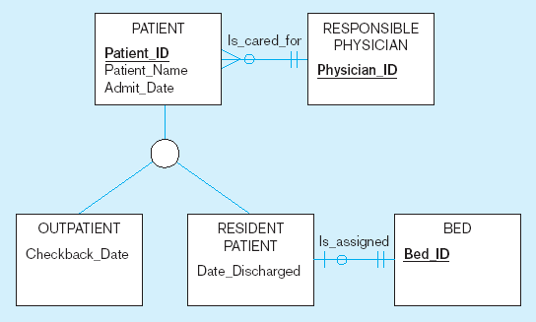
Figure 3-3 Supertype/subtype relationships in a hospital
Both outpatients and resident patients are cared for by a responsible physician
Only resident patients are assigned to a bed

Slide 8
Generalization and Specialization
Generalization: The process of defining a more general entity type from a set of more specialized entity types. BOTTOM-UP
Specialization: The process of defining one or more subtypes of the supertype and forming supertype/subtype relationships. TOP-DOWN

Slide 9
Figure 3-4 Example of Generalization (1 of 2)
a) Initially we may model three entity types: CAR, TRUCK, and MOTORCYCLE
All these types of vehicles have common attributes
Notes:
Sometimes during the conceptual modeling process, we begin to recognize common themes among several entity types. For instance, they may all share many of the same attributes, such as in this example. Here, cars, trucks, and motorcycles all have prices, engine displacements, and vehicle makes and models.

Slide 10
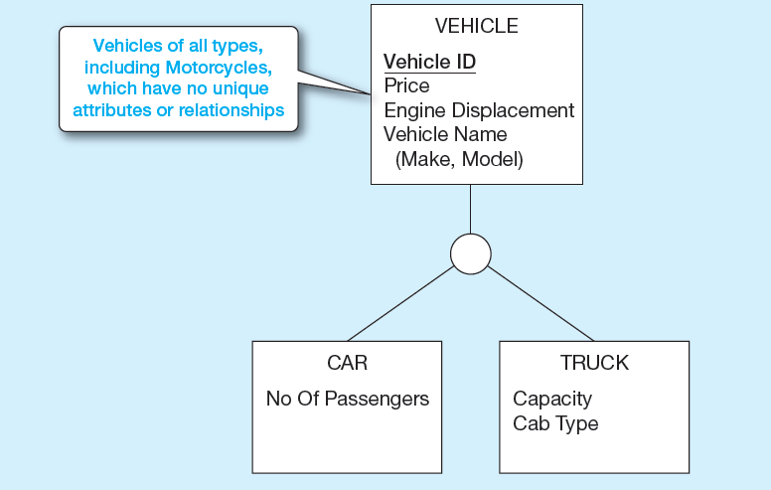
Figure 3-4 Example of Generalization (2 of 2)
b) Generalization to VEHICLE supertype
We put the shared attributes in a supertype. Note: no subtype for motorcycle, since it has no unique attributes
Notes:
So, when this happens, we can create a supertype and place the shared attributes in the supertype entity. This process is called “generalization”.
The specialized attributes go into subtype entities. In the case of the motorcycle, there is no unique attribute, so there is no need for a specific “motorcycle” entity.
Actually, it may be useful to have an indication that a vehicle is in fact a motorcycle. Later we will discuss the concept of a “subtype discriminator”, which is a special attribute at the supertype level that identifies the specific subtype.

Slide 11
From resident student, out-of-state student and foreign student to Student with 3 subtypes
Resident Student:
StudentID, Name, Address, Email, YearsInState
Out-of-state student:
StudentID, Name, Address, Email, StateResidency
Foreign Student:
StudentID, Name, Address, Email, VisaType, VisaNumber, VisaExpirationDate

Slide 12
Student Super/Sub types

Slide 13
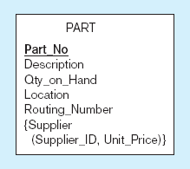
Figure 3-5 Example of specialization
a) Entity type PART
Only applies to manufactured parts
Applies only to purchased parts

Slide 14
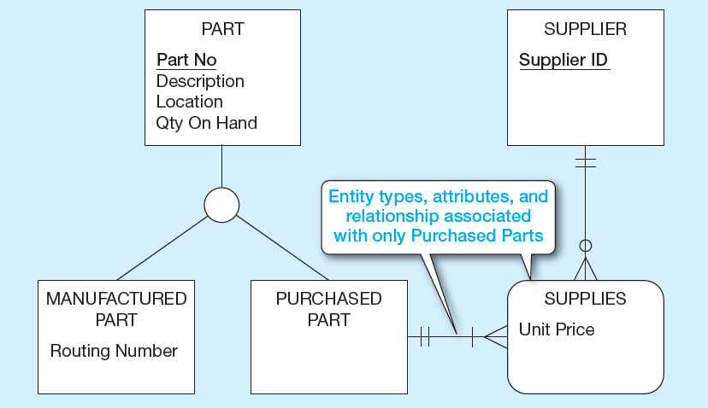
Figure 3-5 Example of Specialization (2 of 2)
b) Specialization to MANUFACTURED PART and PURCHASED PART
Multivalued composite attribute replaced by associative entity relationship to another entity
Notes:
When we find a situation like this, it makes sense to do “specialization”. In this case, we created two subtypes of Part, one for manufactured parts and one for purchased part. All parts have part numbers, descriptions, locations, and quantity. But only manufactured parts have routing numbers, and only purchased parts have suppliers.
Note that unlike the previous slide, the concept of supplier is now represented as a separate entity, and an associative entity represents a M:N relationship between purchased part and supplier, with unit price being an attribute of the associative entity.
This provides information that was not explicit in the previous figure. A multivalued attribute does not explicitly describe a M:N relationship. It could also convey a 1:N relationship. But when you represent the supplier as a separate entity, you can explicitly show the cardinality of relationship.
For an example of a multivalued attribute that implies a 1:N relationship, refer to figure 2.19 from Chapter 2. Here we have time stamps of price history changes. For a given product, there may be many price history items, but each price history item belongs to only one product. That’s different from what we have here with parts and suppliers, where a part can have many suppliers and a supplier could supply many parts.

Slide 15
Student: StudentID, Name, Address,Email, YearsInState, StateResidency, VisaType, VisaNumber, ExpirationDate
Student: StudentID, Name, Address,Email
ResidentStudent: YearsInState
Out-Of-StateStudent: StateResidency
ForeignStudent: VisaType, VisaNumber, ExpirationDate

Slide 16
Student Super/Sub types

Slide 17
Modified Assignment 1, Part 1
Two types of restaurants:
Company owned restaurant:
Attributes: EmployeeID, ManagerFullName, CellPhone, Salary
Franchised: StartingDate
Franchised restaurants relationship
Owner
Contract

Slide 18
Constraints in Supertype/Subtype Relationships
Completeness Constraints: Whether an instance of a supertype must also be a member of at least one subtype
Total Specialization Rule: Yes (double line)
Partial Specialization Rule: No (single line)
Notes:
There are two types of constraints in supertype/subtype relationships. One is called a completeness constraint, and indicates whether there must be an explicit subtype for each possible instance of the supertype. The other is called a disjointness constraint, which indicates whether a particular instance of a supertype could also be more than one of the subtypes.

Slide 19
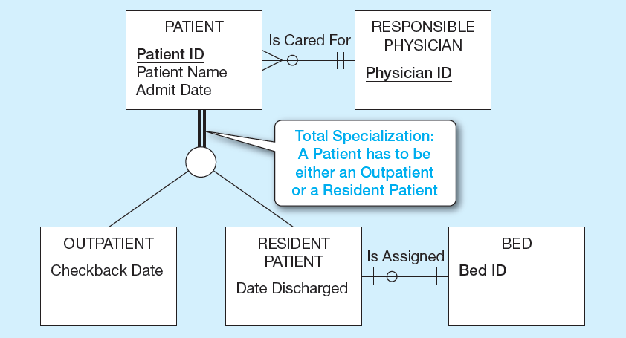
Figure 3-6 Examples of Completeness Constraints (1 of 2)
a) Total specialization rule
Notes:
In this case, a patient MUST either be an outpatient or a resident patient. There is no other possibility. This particular completeness constraint is called total specialization, and is represented by double lines coming down from the supertype entity type.

Slide 20
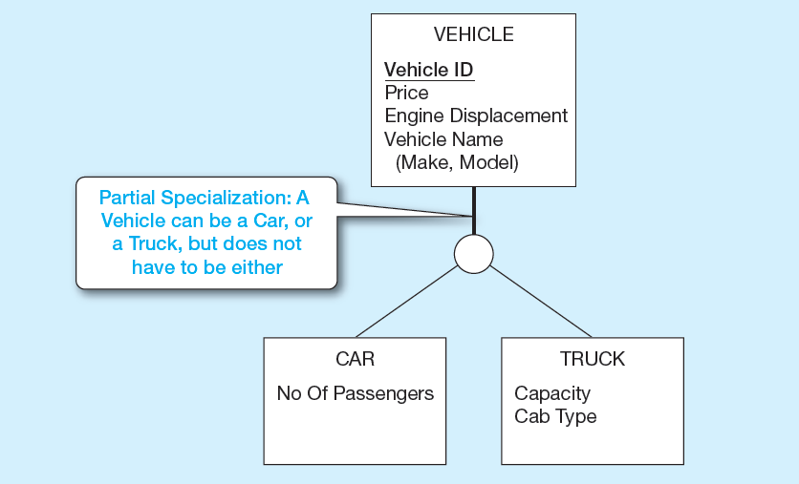
Figure 3-6 Examples of Completeness Constraints (2 of 2)
b) Partial specialization rule (Note: Motorcycle is not required to participate, see slide #8, 9)
Notes:
We already saw this example from earlier. This is partial specialization, because some vehicles are motorcycles, which is not explicitly represented as a subtype entity.
Question: Going back to figure 3-5, do you think the division of PART into manufactured vs. purchased parts implies total specialization or partial specialization ?
Answer: Probably total specialization. Either a part is manufactured in-house or purchased from an external supplier. There is probably no other option.

Slide 21
Constraints in Supertype/Subtype Relationships (1 of 2)
Disjointness Constraints: Whether an instance of a supertype may simultaneously be a member of two (or more) subtypes
Disjoint Rule: An instance of the supertype can be only ONE of the subtypes
Overlap Rule: An instance of the supertype could be more than one of the subtypes
Notes:
There are two types of constraints in supertype/subtype relationships. One is called a completeness constraint, and indicates whether there must be an explicit subtype for each possible instance of the supertype. The other is called a disjointness constraint, which indicates whether a particular instance of a supertype could also be more than one of the subtypes.
So, we can have four possibilities: total specialization with disjoint, total specialization with overlap, partial specialization with disjoint, or partial specialization with overlap.

Slide 22
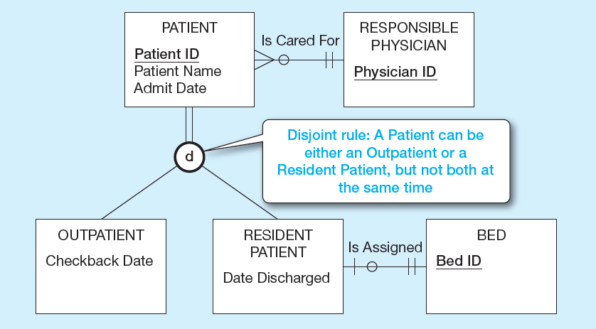
Figure 3-7 Examples of Disjointness Constraints (1 of 2)
a) Disjoint rule
Notes:
Here we see a disjoint (not overlap) rule regarding patients. A patient can’t be both a resident and an outpatient, at least not at the same time. Of course it’s possible for a patient to be a resident for a period of time and then change to an outpatient (or vice versa), but the patient cannot be both simultaneously.

Slide 23
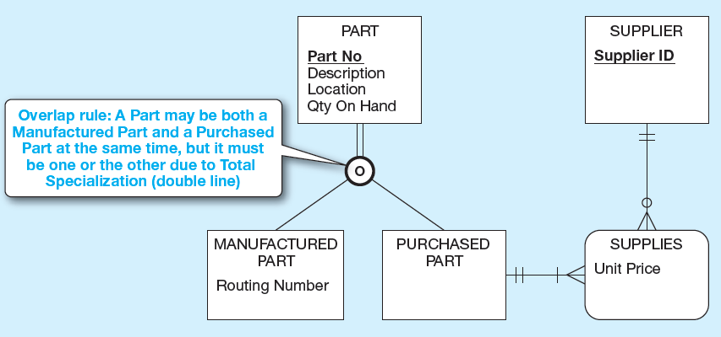
Figure 3-7 Examples of Disjointness Constraints (2 of 2)
b) Overlap rule
Notes:
Here is an overlap rule. Some kinds of parts could be manufactured in-house and also purchased from external suppliers. Note the total specialization rule, which we discussed earlier.

