Slide 1
File Organizations and Indexes
ISYS 464

Slide 2
Data Storage
Disk-based database: non-volatile
Hard disk drive (HDD)
In-memory database:
volatile, non-volatile RAM

Slide 3
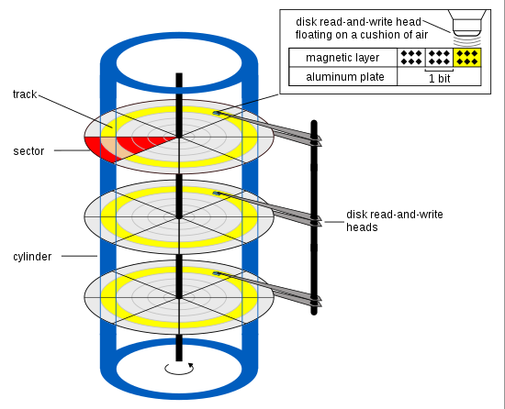
Hard Disk Drive
A record’s physical address is identified by the cylinder, track and sector.

Slide 4
Major disadvantage: Slow
Time Required to Read One Block
Seek time: mechanically moves the read/write head
Rotational delay
Half round
Block transfer time

Slide 5
Updating a Record
Read the block into main memory.
Change the record in main memory.
Write the block back to disk.

Slide 6
File Organizations
Technique for physically arranging records of a file on secondary storage
Types of file organizations
Sequential file
Heap file – unordered sequential file
Ordered sequential
Hashed
B+ Tree file

Slide 7
Unordered Files (Heap Files)
Records are placed in the file in the same order as they are inserted.
Searching: must do a linear search if index is not available.
Updating:
Insertion: Read the last page, append to the last page, then write the page back.
Modification: Search and read the block to main memory. Write the block back after making changes.
Deletion: Mark the record for deletion (deletion flag) and periodically reorganize the file.

Slide 8
Ordered Files
Enable faster searching
binary search
Insertion: May need a temporary overflow file and periodically the overflow file is merged with the ordered file.
Deletion: May need periodical reorganization.

Slide 9
Hash Files (Direct Files)
The page a record is to be stored is determined by a hash function.
Hash function calculates the address of the page based on the key field of the file:
Address = H(Key)
Typical hash function: division/remainder:
0 <= Key Mod M <= M-1
Where M is the number of blocks allocated to this file.

Slide 10
Disk blocks
0
1
Block Address
0
2
1
2
3
3
4
5
4
6
7
5
H(K) -> Block number
Block address: Physical address
6
7

Slide 11
Hash File Example
8 blocks, each block holds 2 records
Hash function: Key Mod 8
Record keys:
Key = 1821, Key Mod 8 = 5
7115, 3
2428, 4
4750, 6
1620, 4
4692, 4 ***** block four is full and unable to take this record

Slide 12
Collision Resolution
Collision: When a record’s home block is full.
Open addressing (linear probing): Place the record in the first available block.

Slide 13
Index
A data structure that allows the DBMS to locate particular records in a file more quickly.
Direct access

Slide 14
Types of Index
Primary index: Index on the primary key field- keep track the physical address of every record.
KeyField + RecordPointer
Index is a file ordered according to the indexing field
Secondary index: Index on a non-key field.

Slide 15
Primary Index on Non Ordered Sequential File
Note 1: The number of index entries equals the number of records.
Note 2: Pointer is the physical address of the data block on the disk.

Slide 16
Primary index on a sequential file that is ordered by the key field
Note: The number of index entries equals the number of file blocks.

Slide 17
Secondary Index on Non-Key Field Using Logical Pointer
When primary key index is available, index on nonkey field can use record keys as logical pointers. Example, index on the major field.
The location of S12 can be found by search the primary index.

Slide 18
Searching with Index
First, search the index file to locate record’s physical address.
Then, directly access the record using the address.

Slide 19
B+ Tree: Indexed and Ordered Sequential File
B+ Tree is an advanced method of indexed sequential file organization. It uses the same concept of key-index, but in a tree like structure. B+ tree stores all the records only at the leaf node.
It is a balanced tree, the length from the root to every leaf node is the same.

Slide 20
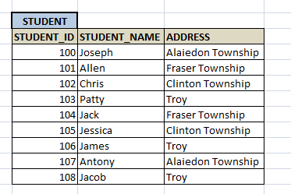
B+ Tree Example https://www.tutorialcup.com/dbms/b-plus-tree.htm

Slide 21
B+ Tree Index and File Example
Note 1: Records are stored in the bottom nodes (leave node).
Note 2: The file is automatically in the sorted order.
Note 3: The tree’s height can grow higher or lower dynamically.

Slide 22
Too many indexes will slow down update operations.
Simple reason: DBMS must update indexes when a update occurred to a record.

Slide 23
Rules for Using Indexes
Use on larger tables
Index the primary key of each table
Index the foreign key
Index search fields (fields frequently in WHERE clause)
Index Fields in SQL ORDER BY and GROUP BY commands
When a non-key field contains a large number of distinct values
. When there are >100 values but not when there are <30 values
. Index the Sex field? Probably not.
7. Use indexes heavily for non-volatile databases; limit the use of indexes for volatile databases
Why? Because modifications (e.g. inserts, deletes) require updating the index files.

Slide 24
Index will speed up join
Faculty File:
Student File:
Primary index on fid
Primary index on sid
Secondary index on foreign key fid

Slide 25
How to index JSON document?
Encourage you to do a self-study

Slide 26
Column Oriented Databases (also known as columnar or C-store) https://dataschool.com/data-modeling-101/row-vs-column-oriented-databases/
A table is stored one column at a time such that each row of a column will be next to other rows from that same column.
Support big data analysis.

Slide 27
Example
Row oriented database:
Column oriented database:

Slide 28
Adding a new record
Frequently, data analyses are performed on computing one column. For example, compute the sum of the ages. With C-Store, computer only needs to read blocks with age data.

Slide 29
In-Memory Database https://www.ionos.com/digitalguide/hosting/technical-matters/in-memory-databases/
A database management system that stores its data collections directly in computer’s RAM.
With today’s 64-bit main memory, the maximum RAM capacity can reach Terabyte , power(2, 64), and big enough to load the whole database.
The key advantage:
significantly faster access speeds. Stored data is then available very quickly when needed.

Slide 30
In-memory columnar database
Stores tables in memory using a columnar format optimized for rapid scans.
Improves performance for real-time analytics.

Slide 31
To prevent data loss
Snapshot files: A snapshot is a copy of the database consistent at a specific time.
Transaction log: Used in combination with the snapshots, the transaction protocol can help restore a system after a crash.
Replication: storing an exact copy of the database on a conventional hard disk.
Non-volatile RAM memory: a non-volatile RAM memory.

Slide 32
SAP HANA: high-performance in-memory analytic appliance

