Slide 1
File Processing

Slide 2
Introduction to File Input and Output
For program to retain data between the times it is run, you must save the data
Data is saved to a file, typically on computer disk
Saved data can be retrieved and used at a later time
“Writing data to”: saving data on a file
Output file: a file that data is written to

Slide 3
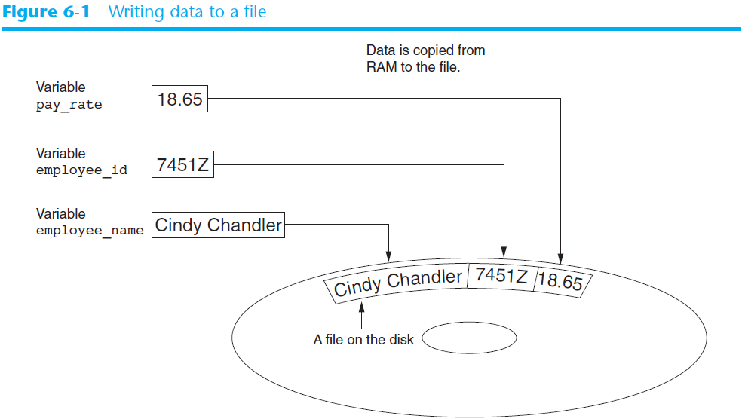

Slide 4
Introduction to File Input and Output (cont’d.)
“Reading data from”: process of retrieving data from a file
Input file: a file from which data is read
Three steps when a program uses a file
Open the file
Process the file
Close the file

Slide 5
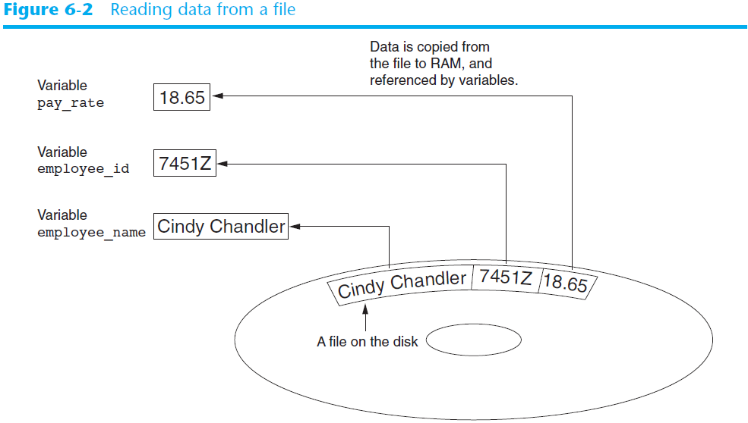

Slide 6
Types of Text Files
Text file: contains data that has been encoded as text, and a file has a file name.
Text file with txt extension
CSV file: Comma Separated Values with a csv extension.

Slide 7
Text File Processing
open function: used to open a file
Creates a file object and associates it with a file on the disk
General format: file_object = open(filename, mode)
Mode: string specifying how the file will be opened
"r" - Read - Default value. Opens a file for reading, error if the file does not exist
"a" - Append - Opens a file for appending(adding), creates the file if it does not exist
"w" - Write - Creates the file if it does not exist, but will overwrite any existing file with the same name.
Close: Close a file after processing

Slide 8
Create a New File mode=“w”
fobj = open("fruits.txt", "w")
# fobj = open("fruits.txt", mode="w")
fobj.write("Apple\n")
fobj.write("Orange\n")
fobj.write("Banana\n")
fobj.close()
Note: A filename that does not contain a path assumes that file is in same directory as program. Add “\n” to write the data on a new line.

Slide 9
Open a File for Reading Mode=“r”
A file object, which has a read() method for reading the whole content of the file:
fobj = open("fruits.txt", "r")
print(fobj.read())
fobj.close()
Output: AppleOrangeBanana

Slide 10
Read one line by using the readline() method
fobj = open("fruits.txt", "r")
print(fobj.readline())
print(fobj.readline())
print(fobj.readline())
fobj.close()
Apple
Orange
Banana

Slide 11
Looping through all the lines of the file
fobj = open("fruits.txt", "r")
for x in fobj:
print(x)
fobj.close()

Slide 12
Open a file to add new text mode=“a”
fobj = open("fruits.txt", "a")
fobj.write("Kiwi\n")
fobj.write("Strawberry\n")
fobj.close()

Slide 13
Open a text file and search
#Text frequency analysis
fobj = open("textFrequencyTxt.txt", "r")
paragraphs=fobj.read().lower()
#print(paragraphs)
continueFlag=True
while continueFlag:
text=input('Enter a word to analyze: ').lower()
if text in paragraphs:
count=paragraphs.count(text)
print('There are {} {}'.format(count,text))
else:
print('{} is not found in the paragraphs'.format(text))
if(input('Do you want to enter another text?(y/n)').lower()=='n'):
break

Slide 14
File Concepts
File consists of a group of records. Each record contains a group of fields.
Example: Student file
SID Sname Major Sex GPA
S1 Peter CIS M 3.0
S3 Paul ACCT M 2.7
S5 Mary CIS F 3.2

Slide 15
Employee File
EmpID Ename Sex HireDate Salary
E1 Peter M 7/4/2020 7000
E2 Paul M 12/25/2020 9000
E3 Mary F 1/1/2019 8000

Slide 16
CSV File Comma Separated Values with a csv extension
A comma-separated values (CSV) file is a delimited text file that uses a comma to separate values. Each line of the file is a data record. Each record consists of one or more fields, separated by commas.
CSV is a common data exchange format that is widely supported by consumer, business, and scientific applications.
Very popular for data analytics and data science studies.

Slide 17
A CSV File Example

Slide 18
Writing and Reading a CSV File https://realpython.com/python-csv/
Writer object: We can write to a CSV file using a writer object and the .write_row() method.
Reader object: Reading from a CSV file is done using the reader object. The CSV file is opened as a text file with Python’s built-in open() function, which returns a file object.

Slide 19
Create a emp.csv file with 3 records with fields:EmpID, Ename, Sex, HireDate, Salary
'e1','peter','m','07/04/2020',7000.00
'e2','paul','m','12/25/2018',8000.00
'e3','mary','f','03/08/2018',7500.00

Slide 20
import csv to define a writer A record is represented as a list
import csv
empfile=open('emp.csv', mode='w',newline="")
empwriter = csv.writer(empfile)
empwriter.writerow(['e1','peter','m','07/04/2020',7000.00])
empwriter.writerow(['e2','paul','m','12/25/2018',8000.00])
empwriter.writerow(['e3','mary','f','03/08/2018',7500.00])
print("File created.")
empfile.close()
Note 1: Without the newline=“”, the writer will add a blank line in the file.
Note 2: import csv

Slide 21
Using a “with” statement
import csv
with open('emp.csv', mode='w',newline="") as empfile:
empwriter = csv.writer(empfile)
empwriter.writerow(['e1','peter','m','07/04/2020',7000.00])
empwriter.writerow(['e2','paul','m','12/25/2018',8000.00])
empwriter.writerow(['e3','mary','f','03/08/2018',7500.00])
print("File created.")
empfile.close()

Slide 22
quoting=csv.QUOTE_NONNUMERIC
import csv
with open('emp.csv', mode='w',newline="") as empfile:
empwriter = csv.writer(empfile,quoting=csv.QUOTE_NONNUMERIC)
empwriter.writerow(['e1','peter','m','07/04/2020',7000.00])
empwriter.writerow(['e2','paul','m','12/25/2018',8000.00])
empwriter.writerow(['e3','mary','f','03/08/2018',7500.00])
print("File created.")
empfile.close()

Slide 23
without quoting=csv.QUOTE_NONNUMERIC
e1,peter,m,07/04/2020,7000.0
e2,paul,m,12/25/2018,8000.0
e3,mary,f,03/08/2018,7500.0
with quoting=csv.QUOTE_NONNUMERIC
"e1","peter","m","07/04/2020",7000.0
"e2","paul","m","12/25/2018",8000.0
"e3","mary","f","03/08/2018",7500.0

Slide 24
Define a reader
import csv
empfile=open('emp.csv')
empreader = csv.reader(empfile)
for row in empreader:
print(row)
empfile.close()
Note: each row is stored as a list, and all the fields including numeric field are quoted.
['e1', 'peter', 'm', '07/04/2020', '7000.0']
['e2', 'paul', 'm', '12/25/2018', '8000.0']
['e3', 'mary', 'f', '03/08/2018', '7500.0']

Slide 25
Using a “with” statement
import csv
with open('emp.csv', mode='r') as empfile:
empreader = csv.reader(empfile)
for row in empreader:
print(row)
empfile.close()

Slide 26
Access each field using index
import csv
with open('emp.csv', mode='r') as empfile:
empreader = csv.reader(empfile)
for row in empreader:
print(row)
print('empid: '+row[0]+', empname: '+row[1]+', sex: '+row[2]+', hire date: '\
+row[3]+', salary:'+row[4])
print('empid: {}, empname: {}, sex: {}, hire date: {}, salary:{}'.format(row[0],\
row[1],row[2],row[3],row[4]))
empfile.close()

Slide 27
Compute the total and averge salary
import csv
with open('emp.csv', mode='r') as empfile:
empreader = csv.reader(empfile)
totalSalary=0
empCount=0
for row in empreader:
#totalSalary+=row[4] ###
totalSalary+=float(row[4]) ###convert to floating number
empCount+=1
print("total salary is: ${:,.2f}".format(totalSalary))
avgSalary=totalSalary/empCount
print("The average salary is: ${:,.2f}".format(avgSalary))
empfile.close()
Note:Salary is presented with quotation and is string:
[ 'e1', 'peter', 'm', '07/04/2020', '7000.0']

Slide 28
Class Example: employee class Each row is represented as an object
Properties: EmpID, Ename, sex, HireDate, Salary
Methods: Calculations applied to the class
taxWithhold: 15% of the salary will be withheld for tax purpose
socialSecurityBenefit: The Social Security FICA tax is based on the first $87,900 paid at the rate of 6.2% with a maximum amount withheld of $5450. The Medicare FICA tax is based on all earnings paid, at the rate of 1.45%.
seniorityStatus: An employee is classified as senior employee if works more than 10 years, otherwise, is junior employee.

Slide 29
Create employee class objects from data in a CSV file
import csv, classModule
with open('emp.csv', mode='r') as empfile:
empreader = csv.reader(empfile)
for row in empreader:
myEmp=classModule.employee(row[0],row[1],row[2],row[3],float(row[4]))
print('empid: '+myEmp.empID+', empname: '+myEmp.ename+', sex: '+myEmp.sex+', hire date: '+myEmp.hireDate+', salary:'+ str(myEmp.salary))
print('Your social security benefit is: ' + str(myEmp.socialSecurityBenefit()))
empfile.close()
Note: Why float(row[4]))? Even though the salary looks like numeric, the reader will actually return it as string: "e1","peter","m","07/04/2020",7000.0.

Slide 30
Create a list of employee objects and retrieve information from the list
import csv, classModule
empList=[]
with open('emp.csv', mode='r') as empfile:
empreader = csv.reader(empfile)
for row in empreader:
myEmp=classModule.employee(row[0],row[1],row[2],row[3],float(row[4]))
empList.append(myEmp)
empfile.close()
print('We have {} employees'.format(len(empList)))
totalSalary=0
for emp in empList:
totalSalary+=emp.salary
print('Total salary in payroll is ' + "${:,.2f}".format(totalSalary))
avgSalary=totalSalary/len(empList)
print("The average salary is: ${:,.2f}".format(avgSalary))
We have 3 employees
Total salary in payroll is $22,500.00
The average salary is: $7,500.00

Slide 31
Adding a new employee record mode=‘a’
import csv
empfile=open('emp.csv', mode='a',newline="")
empid=input('Enter employee id: ')
empname=input('Entername:' )
gender=input('Enter gender: ')
hiredate=input('Employee hire date: ')
salary=input('Enter salary: ')
empwriter = csv.writer(empfile)
empwriter.writerow([empid,empname,gender,hiredate,salary])
empfile.close()

Slide 32
Python connecting to MS Access https://datatofish.com/how-to-connect-python-to-ms-access-database-using-pyodbc/
Step 1: Install the Pyodbc package
pip: It is a package manager for Python packages.
pip install pyodbc
Database driver: It is an adaptor program that enables a connection between a database management system and other systems.
Microsoft ODBC: Open Database Connectivity
Java: JDBC
Python: pyodbc

Slide 33
Step 2: Create the database and table in Access
UnivDB.mdb
Employee table
employee
empID | empName | sex | hireDate | salary
e1 | peter | m | 07/04/2020 | 70000
e2 | paul | m | 12/25/2018 | 8000
e3 | mary | f | 03/08/2018 | 7500

Slide 34
Step 3: Connect Python to Access
Driver connecting MS Acess and Python: conn = pyodbc.connect(r'Driver={Microsoft Access Driver (*.mdb, *.accdb)};'\r'DBQ=C:\HomePage\UnivDB.mdb;')
Step 4: Execute SQL commands to retrieve data from the database.

Slide 35
Code example: Run SQL Select command to retrieve records
import pyodbc
conn = pyodbc.connect(r'Driver={Microsoft Access Driver (*.mdb, *.accdb)};'\
r'DBQ=C:\HomePage\UnivDB.mdb;')
cursor = conn.cursor()
cursor.execute('select * from employee')
for row in cursor.fetchall():
print(row.empID,row.empName,row.sex,row.hireDate,row.salary)

Slide 36
Create a list of employees and compute average salary
import pyodbc, employeeClass
conn = pyodbc.connect(r'Driver={Microsoft Access Driver (*.mdb, *.accdb)};'\
r'DBQ=C:\HomePage\UnivDB.mdb;')
cursor = conn.cursor()
cursor.execute('select * from employee')
empList=[]
for row in cursor.fetchall():
myEmp=employeeClass.employee(row.empID,row.empName,row.sex,row.hireDate,row.salary)
empList.append(myEmp)
sumSalary=0
for emp in empList:
sumSalary+=float(emp.salary)
avgSalary=sumSalary/len(empList)
print('We have {} employees, and the averge salary is: ${:,.2f}.'\
.format(len(empList),avgSalary))
We have 3 employees, and the averge salary is: $28,500.00.

Slide 37
Use SQL count, avg functions
import pyodbc, employeeClass
conn = pyodbc.connect(r'Driver={Microsoft Access Driver (*.mdb, *.accdb)};'\
r'DBQ=C:\HomePage\UnivDB.mdb;')
cursor = conn.cursor()
cursor.execute('select count(empID) as empCount, avg(salary) as avgSal from employee')
for row in cursor.fetchall():
empCount=row.empCount
avgSalary=row.avgSal
print('We have {} employees, and the averge salary is: ${:,.2f}.'\
.format(empCount,avgSalary))

