Slide 1
MongoDB Atlas
A fully-managed cloud Database-as-a-Service (DBaaS)
Tutorial: https://www.mongodb.com/basics/mongodb-atlas-tutorial

Slide 2
Apply for a free mongoDB Atlas account:
  https://www.mongodb.com/atlas/database
  Use MongoDB Atlas to create databases and collections
Download MongoDB Compass: the GUI for MongoDB Atlas to explore and manipulate your database
https://www.mongodb.com/docs/compass/current/install/

Slide 3
After login: Organization/Projects/Project 0

Slide 4
Project 0: Cluster 0/Database
1. Database Access – Create database users
2. Browse Collections – Create new database

Slide 5
To add a new database user:
Click Database Access, and then click ADD NEW USER

Slide 6
Enter user name and password

Slide 7
Database Storage: Project 0/ Cluster0

Slide 8
MongoDB Cluster and Databases
A MongoDB cluster may contain many databases.
A MongoDB database may contain many collections.
A MongoDB collection may contain many documents.
A MongoDB document is a JSON document.

Slide 9
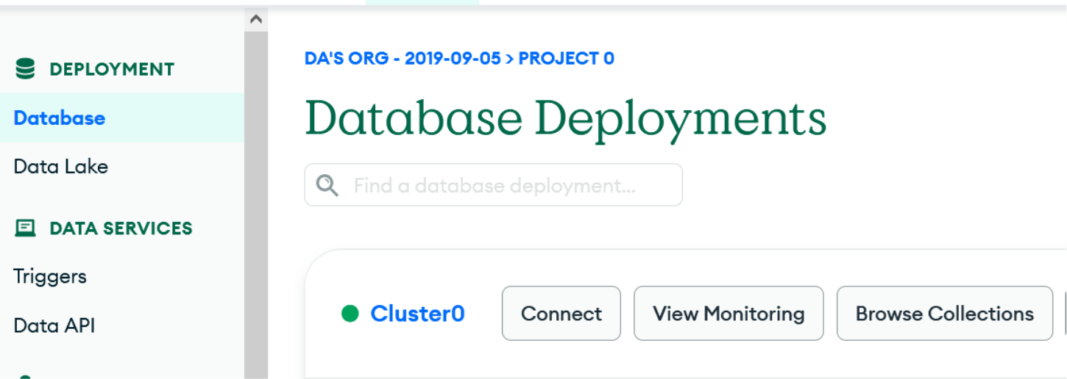
Create a new database with a collection:
From Cluster 0, click Browse Collections, then click the Create Database button

Slide 10
Enter Database name and Collection name:
Example: database name: mydb collection name:employee

Slide 11
MongoDB Compass: the GUI for MongoDB Atlas to explore and manipulate your database
We use MongoDB Compass to:
1. Maintain database: Creating databases with collections, and adding, updating and deleting documents.
2. Query database

Slide 12
Connect MongoDB Compass to Mongo Database
Server-side tasks:
  Create database user with username and password
  Create database with collections
  Get connection string which will be used my MongoDB Atlas to connect to the MongoDB database
Client-side tasks:
  Get the connection string from the MongoDB server
  Use the connection string to connect to the server
  Perform database maintenance and query activities

Slide 13
Server-side tasks:
From Clusters/Cluster0, Click the CONNECT button

Slide 14
Click: Connect with MongoDB Compass(assuming MongoDB Compass already installed)

Slide 15
Click the “I have Compass” if you already install it. And then click the Copy button to copy the connection string

Slide 16
Client-side tasks to connect to MongoDB Atlas from Compass
Click: Connect, then paste the connection string to the box (use Control/V to paste the connection string), and enter the database username and password (not the MongoDB Atlas username and pwd).

Slide 17
Click Databases

Slide 18
To add a new document: click: Insert Document

Slide 19
Use Tab to move to the value, and Enter to move to the next field. Choose the data type from the dropdown list.
Enter 3 documents:
eid:e1, ename:peter, sex:m, salary: 65000; (choose Double for salary field)
eid:e2,ename:paul, sex:m, salary:75000;
eid:e3, ename:mary, sex=f, salary:70000.

Slide 20
Add a new collection under mydb
Click the Create Database button
Enter database name: mydb
Enter new collection name: newEmployee

Slide 21
To delete a collection:
Point to the collection and click the Delete button

Slide 22
To add a new document to employee collection:
Click employee collection; then click ADD DATA and Insert Document

Slide 24
MongoDB Compass Query Filter
https://docs.mongodb.com/compass/master/query/filter/
https://docs.mongodb.com/manual/tutorial/query-documents/
Query nested document:
  https://docs.mongodb.com/manual/tutorial/query-embedded-documents/
Query array:
  https://docs.mongodb.com/manual/tutorial/query-arrays/

Slide 25
Query Operators for comparison https://docs.mongodb.com/manual/reference/operator/query/
Name Description
$eq Matches values that are equal to a specified value.
$gt Matches values that are greater than a specified value.
$gte Matches values that are greater than or equal to a specified value.
$in Matches any of the values specified in an array.
$lt Matches values that are less than a specified value.
$lte Matches values that are less than or equal to a specified value.
$ne Matches all values that are not equal to a specified value.
$nin Matches none of the values specified in an array.
Example:$in
  { RATING: { $in: ["A","C" ] } }

Slide 26
Query filter examples
Note: Field name and data are case-sensitive.
{sex:"m"}, or {sex:{$eq:"m"}}
{salary:{$gt:50000}}
{sex:"m",salary:{$gt:50000}}
Objects that have no eid field value:
  {eid:null}

Slide 27
Example of query filter: {sex:"m"}

Slide 28
Click Options to add projection or Sort

Slide 29
Project Fields to Return from Query https://docs.mongodb.com/manual/tutorial/project-fields-from-query-results/
Suppress sex,salary,and _id fields: {sex:0,salary:0,_id:0}
  Equivalent to project eid,ename
Project eid, ename: {eid:1,ename:1}

Slide 30
Sorting
Increasing order 1: {sex:1}
Decreasing order -1: {sex:-1}
{sex:1,ename:1}

Slide 31
Logical Operators for Complex Conditions
Name Description
$and Joins query clauses with a logical AND returns all documents that match the conditions of both clauses.
$not Inverts the effect of a query expression and returns documents that do not match the query expression.
$nor Joins query clauses with a logical NOR returns all documents that fail to match both clauses.
$or Joins query clauses with a logical OR returns all documents that match the conditions of either clause.
Example: {$or: [ { CITY: "SF" }, {RATING:"A" }]}

Slide 32
Example:
AND:
  {$and: [ { CITY: "SF" }, {RATING:"A" }]}
  MongoDB provides an implicit AND operation when specifying a comma separated list of expressions.
    { CITY: “SF" }, {RATING:"A" }
OR:
  { $or: [ { CITY:"SF" }, { RATING:"A"}] }
Find customers living in SF and have A or C rating
  {$and:[{CITY:"SF"},{$or:[{RATING:"A"},{RATING:"C"}]}]}
Find customers who have C rating or live in SF with A rating:
  {$or:[{RATING:"C"},{$and:[{RATING:"A"},{CITY:"SF"}]}]}

Slide 33
Element Operators
Name Description
$exists Matches documents that have the specified field.
$type Selects documents if a field is of the specified type.
Documents do not have eid field: {eid:{$exists:false}}
Documents that do not have the RATING field:
  { RATING: { $exists: false } }
Find documents that have the RATING field with value A or C:
  { RATING: { $exists: true ,$in:["A","C"] }}

Slide 34
Aggregation Pipeline Builder https://docs.mongodb.com/compass/master/aggregation-pipeline-builder/

