Slide 1
Download MySQL Installer: https://dev.mysql.com/downloads/mysql/
  For Windows 11/Mac OS 13: Choose 8.1.0 Innovation
  For Windows 10/Mac OS 12: Choose 8.0.34

Slide 4
Root Account (This is MySQL Admin account)
Set and remember the password

Slide 5
Other configuration issues
Root Account Password:
  During the installation, you will be asked to enter a password for the “root” account and is required.
  You will be asked for it when performing other MySQL Installer operations. Be sure to remember the password for “root”.
After installing the software, you may add new users with user name, password and their role.

Slide 6
MySQL Reference Manual
MySQL 8.1:
  https://dev.mysql.com/doc/refman/8.1/en/
MySQL 8.0:
  https://dev.mysql.com/doc/refman/8.0/en

Slide 7
Switching between MySQL 8.0 and 8.1
(In case you have both 8.0 and 8.1 installed)
Ctrl/Alt/Del;
  Task Manager
    Service
      MySQL 8.0 Start/Stop
      MySQL 8.1

Slide 8
MySQL Workbench https://www.mysql.com/products/workbench/
This program is installed automatically.
MySQL Workbench is a unified visual tool for database architects, developers, and DBAs. MySQL Workbench provides data modeling, SQL development, and comprehensive administration tools for server configuration, user administration, backup, and much more.

Slide 10
Connect to a database

Slide 11
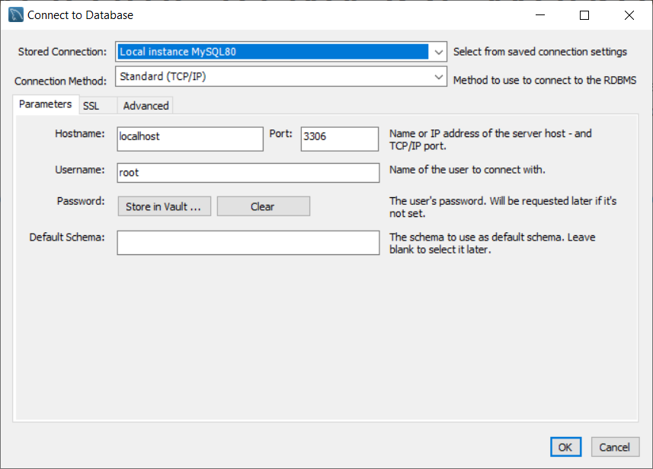

Slide 12
Administration window/Schemas window:
Note 1: Under Administration, you may add new user, and other functions.
Note 2: Use Schemas window to create new database schema.

Slide 13
Schemas Window

Slide 14
Schemas Window
Creating a New MySQL Database Schema
Right-click on the list of existing Schemas and select Create Schema.
Or click the Create a new schema button

Slide 15
Enter a name for the schema. Then click Apply.
In the Apply SQL Script to Database window, click Apply to run the SQL command that creates the schema.
Click Finish. You can see the new schema, which has no tables, listed in the left pane.
Exercise:
  Create a new schema: mydb

Slide 16
Create a Table using MySQL Workbench https://www.quackit.com/mysql/workbench/create_a_table.cfm
With the chosen database expanded in the SCHEMAS tab, right click on Tables and select Create Table.
Enter the table name at the top (next to Name:) and add all column names, their data type, constraints, default values, and any other details you require.

Slide 17
Exercise: Create a new table: emptable fields: empid, char(10), and is the primary key field empname, varchar(45)

Slide 18
Enter records
Click: refresh schema
Right click emptable and click “select rows”
Click Insert New Row button

