Slide 1
Implementation:
Creating Database Using MySQL Workbench and SQL DDL

Slide 2
Database Schema
A database schema defines how data is organized within a relational database; this is inclusive of logical constraints such as, table names, fields, data types, and the relationships between these entities.
The Data Definition Language, DDL, of the Structured Query Language, SQL, is used to define database schema.
MySQL Workbench offers visual support to define database schema and generate DDL code automatically.

Slide 3
Major Steps in a Creating Database
Create schema:
  A schema may contains many tables.
Create tables:
  Define columns and columns’ data type
Create constraints:
  Primary key constraints
    Every table must have a key field
  Domain constraints
    Default value
    Column’s acceptable values
  Referential integrity
    Maintain relationship between entities

Slide 4
Brief History of SQL
Developed in early 1970 for relational data model:
  Structured English Query Language (SEQUEL)
  Implemented with IBM System R
1987 first ISO standard version
1992 SQL 2
1999 SQL 3
  Object-relational model
2003:SQL 2003
  SQL/XML
2016: SQL 2016
  Adding JSON support
2019: SQL 2019 – adding support for multidimensional array
2023: adding support to access graphs stored in SQL tables.

Slide 5
Four major components of SQL
Data Definition Language, DDL
    Create Schema
    Create Table
    Alter Table
    Create constraint
Data Manipulation Language, DML
    Updating database: Insert, Delete, Update
Data Query Language, DQL
    Select command
Data Control Language (DCL)
    Help DBA control the database:
      Grant/revoke privileges to access the database, creating procedures, etc.

Slide 6
Extensions to Standard SQL
SQL Procedural language
  To create stored procedures, user-defined functions, triggers, etc.
Example
  Oracle: PL/SQL, MySQL SQL/PSM (SQL/Persistent Stored Modules)
  Microsoft SQL Server: Transact-SQL (T-SQL)
  IBM DB2: SQL Procedural Language

Slide 7
Using MySQL Workbench to define database schema
Administration window/Schemas window
Note 1: Under Administration, you may add new user, and other functions.
Note 2: Use Schemas window to create new database schema.

Slide 8
Schemas Window
To create a New Database Schema:
Right-click on the list of existing Schemas and select Create Schema.
Or click the Create a new schema button

Slide 9
SQL Identifier: the name of a database object such as database schemas, tables, columns, views, indexes, and stored procedure names.
SQL Identifier rules:
  Character set: A-Z, a-z, 0-9, _
  <= 128 characters
  Start with a letter
  Cannot contain spaces
Note: MySQL uses lowercase letters for all identifiers.

Slide 10
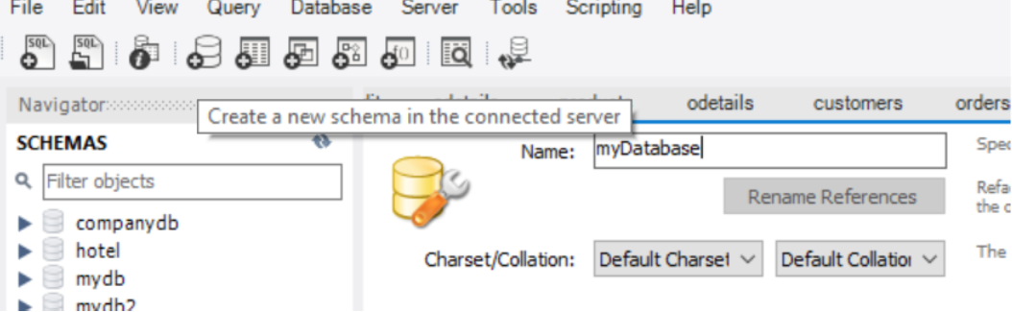
Create a new schema: mydatabase
Enter a name for the schema, mydatabase. Then click Apply.
In the Apply SQL Script to Database window, click Apply to run the SQL command that creates the schema.
Click Finish. You can see the new schema, which has no tables, listed in the left pane.

Slide 11
Workbench generates SQL Create Schema command
CREATE SCHEMA schemaName;

Slide 12
Create a Table using MySQL Workbench https://www.quackit.com/mysql/workbench/create_a_table.cfm
With the chosen database expanded in the SCHEMAS tab, right click on Tables and select Create Table.
Enter the table name at the top (next to Name:) and add all column names, their data type, constraints, default values, and any other details you require.

Slide 13
Table Columns and Data Types
Boolean
  True, False, Unknown (for Null)
Character
  Fixed length: CHAR(n), CHAR – default to 1 character
  Varying length:
    VARCHAR(n): Maximum length is n
Numeric
  DECIMAL(i,j)
  INTEGER, INT, SMALLINT – up to 32767
  FLOAT, REAL, DOUBLE PRECISION
Date:
  DATETIME
  TIMESTAMP
Large objects:
  CHARACTER LARGE OBJECT
  BINARY LARGE OBJECT
JSON, Set

Slide 14
Create a new table under mydatabase
Table name: employee
Fields:
  eid CHAR(5), primary key
  ename VARCHAR(45)
  sex CHAR(1)
  salary DECIMAL(9,2)
  hiredate DATETIME

Slide 15
Workbench generated CREATE TABLE DDL command

Slide 16
SQL CREATE TABLE command
CREATE TABLE tableName(fields and data type separated by commas);
Example:
  CREATE TABLE `mydatabase`.`employee` ( `eid` CHAR(5) NOT NULL, `ename` VARCHAR(45) NULL, `sex` CHAR(1) NULL, `salary` DECIMAL(9,2) NULL, `hiredate` DATETIME NULL, PRIMARY KEY (`eid`));

Slide 17
Enter records to employee table
Right click the employee table and choose: select rows
Then click the Insert new row button:

Slide 18
Enter 3 records:
E1, peter, m, 8500, 2010-08-31
E2, paul, m, 9500, 2011-05-05
E3, mary, f, 8000, 2012-07-04

Slide 19
Workbench generates SQL INSERT INTO statements
INSERT INTO `mydatabase`.`employee` (`eid`, `ename`, `sex`, `salary`, `hiredate`) VALUES ('e1', 'peter', 'm', '8500', '2010-08-31’);
INSERT INTO `mydatabase`.`employee` (`eid`, `ename`, `sex`, `salary`, `hiredate`) VALUES ('e2', 'paul', 'm', '9500', '2011-05-05’);
INSERT INTO `mydatabase`.`employee` (`eid`, `ename`, `sex`, `salary`, `hiredate`) VALUES (‘e3', 'mary', 'f', '8000', '2012-07-04');
Note: MySQL date format: ‘yyyy-mm-dd’

Slide 20
Execute SELECT Commands
Right click the employee table and choose: select rows or Click File/New query tab to open a query window to enter the command
SELECT * FROM mydatabase.employee;
SELECT * FROM mydatabase.employee where sex='m';
SELECT * FROM mydatabase.employee where sex='M';
use mydatabase;
### set mydatabase to be the default database
### Comment, from a # character to the end of the line
SELECT * FROM employee;
Note: Click the Execute Query button.

Slide 21
Composite Key Examples
Example :
  CourseSection Table:
    CourseID, SectionID, Capacity
    Isys 464 Section 1 32
    Isys 464 Section 2 30
    Isys 464 Section 3 36
What is the key of this table?
  CourseID + SectionID

Slide 22
Create a table with a composite key
CourseSection Table:
  CourseID, SectionID, Capacity
    (check PK for courseid and sectionid)

Slide 23
Use Alter Table to change table columns
Right click the table name and choose Alter Table

Slide 24
Alter Table demos with employee table
Add/change/delete a field
  Add a new field: phone, char(10)
  Change phone to: char(12)
  Delete the phone field.

Slide 25
Add a new field: phone, char(10)
Generated code:
ALTER TABLE `mydatabase`.`employee` ADD COLUMN `phone` CHAR(10) NULL AFTER `hiredate`;

Slide 26
Change phone to char(12)
ALTER TABLE `mydatabase`.`employee` CHANGE COLUMN `phone` `phone` CHAR(12) NULL DEFAULT NULL ;

Slide 27
Delete phone field
ALTER TABLE `mydatabase`.`employee` DROP COLUMN `phone`;

Slide 28
Domain Constraints
Add default value for a field:
  Set ‘m’ to be the default value for the sex field
Add domain constraints:
  Set sex field to accept ‘m’ or ‘f’ or ‘x’ only

Slide 29
Alter table
Set ‘m’ to be the default value for the sex field
Change the Default column of sex field to ‘m’ and click Apply
Generated code:
ALTER TABLE `mydatabase`.`employee` CHANGE COLUMN `sex` `sex` CHAR(1) NULL DEFAULT 'm' ;

Slide 30
Use SQL CHECK keyword to add domain constraint
Note: Workbench does not offer visual support to add constraint using CHECK. We must use command to do it.
Command syntax:
ALTER TABLE tablename
ADD CONSTRAINT constraintname
CHECK (criteria);
Example: Add constraint to the sex field to accept only ‘m’ or ‘f’ or ‘x’.

Slide 31
Examples: Adding Domain Constraint using Alter Table command
USE mydatabase;
ALTER TABLE employee ADD CONSTRAINT validSex CHECK (sex in ('M','F','X’));
After creating the constraint, this insert statement will trigger invalid sex error:
insert into employee values('e34','aaa','d', 65000,'2010-07-04’);
Note: You need to adjust the “output” window size to view the messages.

Slide 32
Change the salary field to accept only values less than 100000
ALTER TABLE employee
ADD CONSTRAINT validSalary CHECK (salary <100000);
This insert statement will trigger invalid salary error:
insert into employee values('e35','aaa','m',6000000.0,'2020-10-10');

Slide 33
Dropping Constraints
To drop Check constraint, MySQL uses Drop Check command:
ALTER TABLE employee DROP CHECK validSalary;
  Standard SQL: ALTER TABLE tablename
  DROP CONSTRAINT constraintname;

Slide 34
Change the salary field to accept only values between 1000 and 100000
ALTER TABLE employee
ADD CONSTRAINT validSalaryRange CHECK (salary between 1000 and 100000);
This insert statement will trigger invalid salary range error:
insert into employee values('e35','aaa','m',900.0,'2020-10-10');

Slide 35
SHOW CREATE TABLE Statement
SHOW CREATE TABLE tbl_name
  Shows the CREATE TABLE statement that creates the named table including constraints.
Example:
  Use mydatabase;
  show create table employee;

Slide 36
Renaming a Table
Using Workbench:
  Right click the table name and choose Alter Table
  Change the table name to a new name and then click Apply.

Slide 37
Removing a Table
Using Workbench: Right click the table name and choose Drop Table
Using command line:
  Drop Table tableName;

Slide 38
Referential Integrity
In relationships, data is linked between two or more tables. This is achieved by having the foreign key (in the associated table) reference a primary key value (in the primary – or parent – table).
So, referential integrity requires that, whenever a foreign key value is used it must reference a valid, existing primary key in the parent table.

Slide 39
1:M relationship between Faculty and Student
Faculty table
Student table
Student s3’s record violates the referential integrity.

Slide 40
FOREIGN KEY Constraints https://dev.mysql.com/doc/refman/8.0/en/create-table-foreign-keys.html#foreign-key-referential-actions
A foreign key relationship involves a parent table that holds the initial column values, and a child table with column values that reference the parent column values.
A foreign key constraint is defined on the child table.

Slide 41
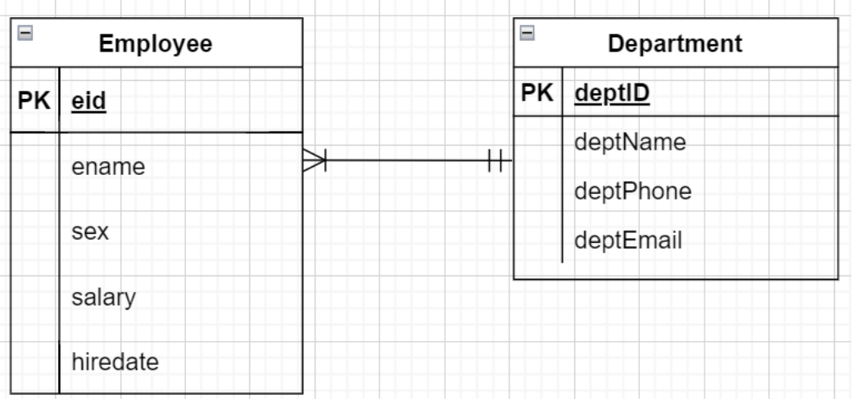
Using Workbench to define foreign key
Example: 1:M relationship between Department and Employee

Slide 42
Exercise: Create a Department Table
Fields:
  DeptID, Char(10)
  DeptName, VarChar(30)
  DeptPhone, Char(10)
  DeptEmail, Char(30)

Slide 43
Add deptID to the employee table
Employee table fields:
  eid CHAR(5), primary key
  ename VARCHAR(45)
  sex CHAR(1)
  salary DECIMAL(9,2)
  hiredate DATETIME
  deptID

Slide 44
Add Foreign Key Constraint
Before creating the foreign key, make sure both parent and child tables have primary key defined.
A foreign key constraint is defined on the child table.
Right-click the Employee table and select Alter Table
Click the Foreign Key tab.

Slide 45
Name the foreign key constraint, deptFK, and select the referenced table (Department), and referenced column, deptID.

Slide 46
Generated Code
ALTER TABLE `mydatabase`.`employee`
ADD CONSTRAINT `deptFK`
FOREIGN KEY (`deptID`) REFERENCES `mydatabase`.`department` (`deptID`)
ON DELETE SET NULL
ON UPDATE CASCADE;

Slide 47
Referential Actions
When an UPDATE or DELETE operation affects a key value in the parent table that has matching rows in the child table, the result depends on the referential action specified by ON UPDATE and ON DELETE subclauses of the FOREIGN KEY clause. Referential actions include:
  CASCADE: Delete or update the row from the parent table and automatically delete or update the matching rows in the child table.
  SET NULL: Delete or update the row from the parent table and set the foreign key column or columns in the child table to NULL.
  RESTRICT: Rejects the delete or update operation for the parent table key field.
  NO ACTION: In MySQL, this is equivalent to RESTRICT.

Slide 48
Referential Actions Examples
If we are deleting department d1’s record:
1. Under On Delete Cascade action, employee e1, e2 will be deleted.
2. Under On Delete Set Null action, the eid of employee e1, e2 will be set to null.
3. Under On Delete Restrict or No Action action, the database system will refuse to delete department d1’s record.

