Slide 1
Advanced SQL Topics
Correlated subquery
Set operators
Outer join
Self join
Database view

Slide 2
Correlated SubQueries https://www.geeksforgeeks.org/sql-correlated-subqueries/
A correlated subquery references values of the main query.
In a correlated subquery, the main query provides values which are used by subquery’s WHERE clause.
The correlated subquery is executed repeatedly, once for each row of the main query table.

Slide 3
Find faculty who advise at least one student
Using correlated subquery: Pass one fid at a time to the subquery to check if that fid exists in the student table.

Slide 4
How to pass value from the main query to the correlated subquery one record at a time?
In the subquery, use this syntax:
  MainQueryTableName.fieldname
Example, to pass a faculty’s fid to the correlated subquery, in the correlated subquery, we enter:
  faculty.fid

Slide 5
EXISTS, NOT EXISTS
This keyword tests whether a correlated subquery returns any rows.
It returns:
  True if at least one record is returned
  False if no record is returned

Slide 6
Find faculty who advise at least one student using correlated subquery
SELECT fid,fname FROM faculty
  WHERE EXISTS (SELECT * FROM student
      WHERE fid = faculty.fid);
The correlated subquery is executed repeatedly, once for each row of the main query table.
Note: Passing value from the main query to the subquery: tableName.fieldName

Slide 7
Q: Find faculty who does not advise any student using correlated subquery
SELECT fid,fname FROM faculty
WHERE NOT EXISTS (SELECT * FROM student WHERE fid = faculty.fid);

Slide 8
NOTE: We can answer the same questions using regular subquery with IN and NOT IN
1 SELECT fid,fname FROM faculty
  WHERE fid in (SELECT DISTINCT fid FROM student);
2. SELECT fid,fname FROM faculty
  WHERE fid not in (SELECT DISTINCT fid FROM student);

Slide 9
Using correlated subquery to return a value
Q: Find all the students who’s GPA is higher than the average GPA in their department
SELECT * FROM student s
where GPA > (select AVG(gpa) from student where major=s.major);

Slide 10
Display students’ ID,Name taking at least 3 courses.
1. Join:
  SELECT sid, sname
  FROM student NATURAL JOIN registration
  GROUP BY sid, sname
  HAVING COUNT(cid) >=3;
2. Subquery:
  SELECT sid, sname FROM student
  WHERE sid IN (SELECT sid FROM registration GROUP BY sid
  HAVING COUNT(cid) >=3);
3. Correlated query:
  SELECT sid, sname FROM student
  WHERE (SELECT COUNT(cid) FROM registration WHERE sid = student.sid) >=3;

Slide 11
SELECT List Containing Correlated Sub Query
SELECT sid, sname, (SELECT COUNT(cid) FROM registration WHERE sid=student.sid) AS courses
FROM student
ORDER BY sid;

Slide 12
Q: Create a query to show:
SID, Sname, StudentGPA, MajorGPA
SELECT sid, sname, gpa as StudentGPA,
(select AVG(gpa) from student s where major=s.major) as MajorGPA
from student;

Slide 13
Set Operators
Union
Intersect
Difference (Minus)
Cartesian product

Slide 14
Union
Set1={A, B, C}
Set2={C, D, E}
Union: Members in Set 1 or in Set 2
  Set1 U Set 2 = {A, B, C, D, E}

Slide 15
Intersect
Set1={A, B, C}
Set2={C, D, E}
Members in Set 1 and in Set 2
  Set1 ∩ Set2 →{C}

Slide 16
Difference
Set1={A, B, C}
Set2={C, D, E}
Set1 – Set2: Members in Set1 but not in set2 = {A,B}
Set2 – Set1:Members in Set2 but not in set1 = {D, E}
Set1-Set2 ≠ Set2 – Set1
Logical operator: NOT

Slide 17
Venn Diagram
Set 1: Young: Age<30
Set 2: Rich: Income>100,000’
Set 1
Set 2
Set 1 – Set 2
Set 2 – Set 1

Slide 18
Run this script code to create a new sales2 database

Slide 19
Files as Sets
Customers table, and CustomersOld table.

Slide 20
Customers UNION CustomersOld
select * from customers
Union
select * from customersOld;

Slide 21
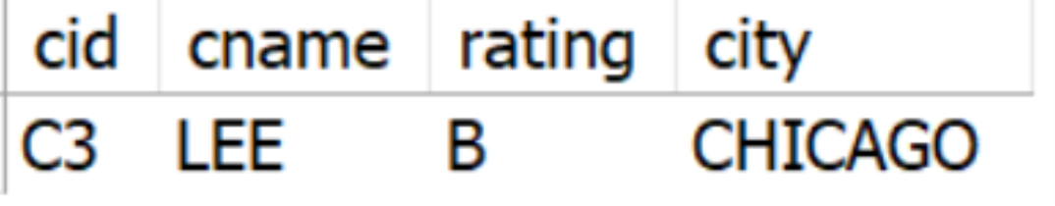
MySQL does not support MINUS
Use NOT IN to simulate the minus operator: Customers – CustomersOld
Note: Results are new customers who are not in the CustomersOld
select * from customers
where cid not in (select cid from customersOld);

Slide 22
Use NOT IN to simulate: CustomersOld – Customers
Note: Resulsts are old Customers who are no longer in the current customers table
select * from customersold
where cid not in (select cid from customers);

Slide 23
Use IN AND IN to Do Intersect
Set1={A, B, C}
Set2={C, D, E}
Intersect: Members in Set 1 and in Set 2
  Set1 ∩ Set2={C} → {C}
Related to logical operator AND
Members IN Set1 AND IN Set2

Slide 24
Customers Intersect CustomersOld
Note: Customers both tables
select * from customers
where cid in (select cid from customers)
and cid in (select cid from customersold);
Or
select * from customers
where cid in (select cid from customersold);

Slide 25
Select orders that order product P1 and P2.
First try:
SELECT * FROM orders natural join odetails
where pid='P1' or pid='P2';
Second try:
SELECT * FROM orders natural join odetails
where pid='P1' and pid='P2';

Slide 26
Use Intersect: (Orders that include P1) intersect (Orders that include P2)
SELECT * FROM orders
where oid in (select oid from odetails where pid='P1')
and oid in ( select oid from odetails where pid='P2');

Slide 27
Union Compatibility
Two relations that have the same number of attributes and same type of attributes.
Union, Intersect and difference operators require the two relations to be union compatible.

Slide 28
Union Compatibility Examples
File 1:
  SID – 9 characters
  Sname – 25 characters
File 2:
  SSN – 9 characters
  Ename – 25 characters
File 3:
  Ename – 25 characters
  EID – 9 characters
File 1 and file 2 are union compatible; file 1 and file 3 are not; file 2 and file 3 are not.

Slide 29
Union Compatibility Example
(sid,sname) and (fid,fname) are compatible
SELECT sid,sname from student
union
SELECT fid,fname from faculty;

Slide 30
Product
Set1 = {a, b, c}
Set2 = {X, Y, Z}
Set1 X Set2 = {aX, aY aZ, bX, bY, bZ, cX, cY, cZ}

Slide 31
MySQL Cross Join
MySQL Cross Join returns the Cartesian product of both the tables. The Cross Join in MySQL does not require any common column to join two tables. The Cartesian product means Number of Rows present in Table 1 Multiplied by Number of Rows present in Table 2.

Slide 32
Customers Cross Join Orders
SELECT * FROM customers cross join orders
order by customers.cid;
Note: This query returns 4*7, 28 records.

Slide 33
Faculty Cross Join Student
SELECT * FROM faculty cross join student
order by faculty.fid;
Note: 3*7,
21 records

Slide 34
Old way of doing product:
select * from faculty, student;;
Note: A two-table join is executed by applying the join condition to the product of the two tables:
select * from faculty, student where faculty.fid=student.fid;

Slide 35
Outer Join
Full outer: Records of the two tables that do not have matching records in the related table are included in the join table. Missing values are set to null.
Left outer: Records in the left side table that do not have matching records in the related table are included in the join table.
Right outer: Records in the right side table that do not have matching records in the related table are included in the join table.

Slide 36
Why we need outer join: Pid, Pname, totalSales

Slide 37
Regular Join
select pid,pname,sum(qty*price) as totalSales
from products natural join odetails
group by pid
order by pid;
Problem: The important fact that P5, P6 has no sales is not shown!

Slide 38
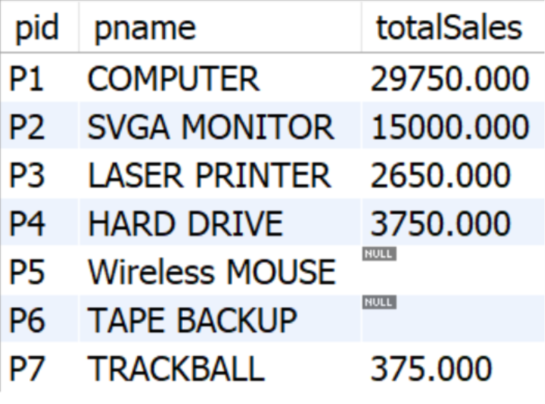
A better total sales report showing no sales for P5, P6

Slide 39
Outer Join Example

Slide 40
Left Outer Join

Slide 41
Right Outer Join

Slide 42
Full Outer Join

Slide 43
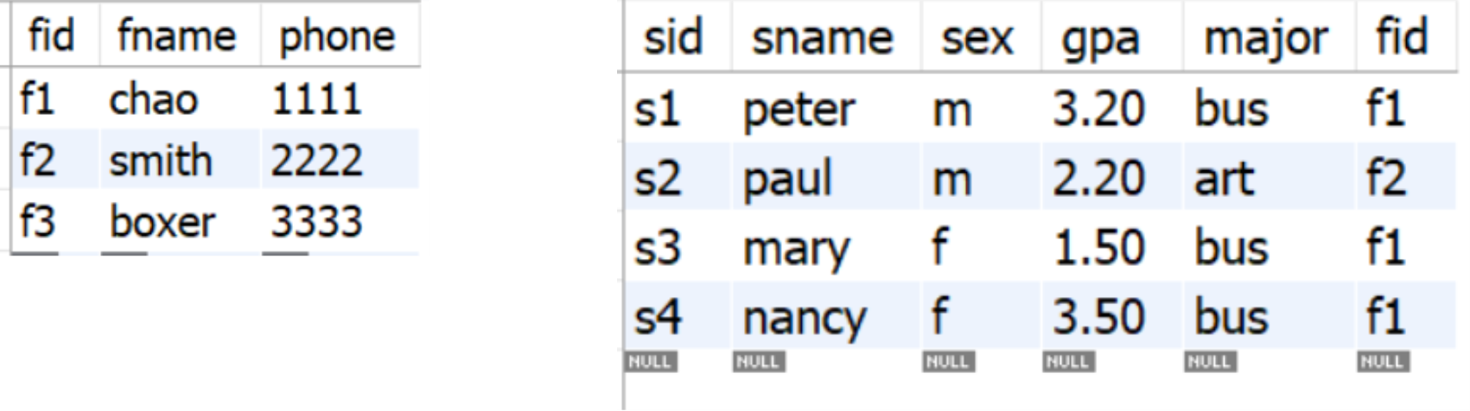
Outer Join Example

Slide 44
Left/Right Outer Syntax
SELECT * FROM Table1 LEFT JOIN table2
ON Table1.Common_Column = Table2.Common_Column;
SELECT * FROM Table1 RIGHT JOIN table2
ON Table1.Common_Column = Table2.Common_Column;

Slide 45
Left Outer Join
select * from
faculty left join student
on faculty.fid=student.fid;

Slide 46
Sales2 Database: Right Outer Example
select * from
customers right join orders
on customers.cid=orders.cid;

Slide 47
Left Outer Example
select * from
customers left join orders
on customers.cid=orders.cid;

Slide 48
Full Outer Join
Full outer join =
  Left Outer Join results UNION Right Outer Join results

Slide 49
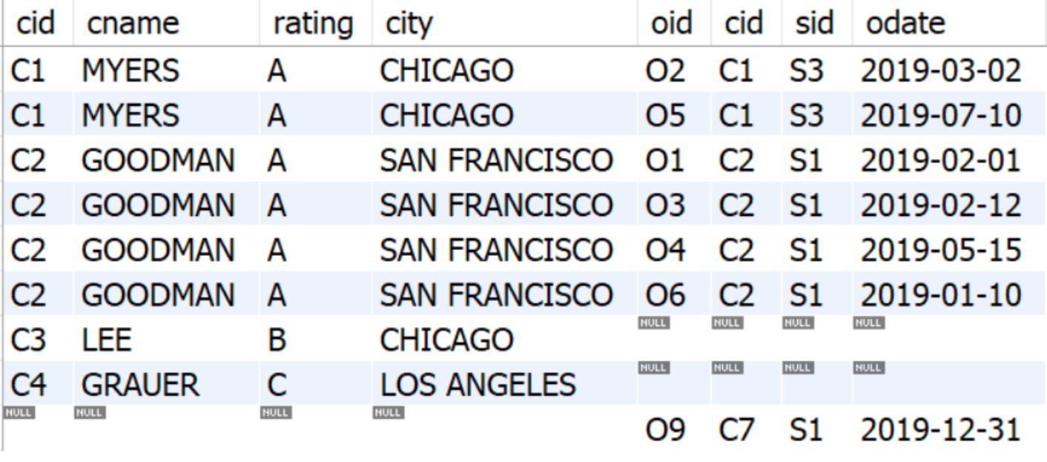
Full Outer Example
(select * from customers left join orders on customers.cid=orders.cid)
UNION
(select * from customers right join orders on customers.cid=orders.cid);

Slide 50
Total Sales by Product using Left Join
select p.pid,pname,sum(qty*price) as totalSales
from products p left join odetails o
on p.pid=o.pid
group by pid;

Slide 51
Self Join
Recursive relationship:
  Employee supervise Employee
Use the Employee table of the mydatabase to create a new table named: employeeAndSuper
  create table employeeAndSuper as(select * from employee);
Use Alter Table to set the primary key and add a new field: supervisorID, and Apply.
Add values tosupervisorID:

Slide 52
Find employees’ supervisor name:
SELECT e.eid, e.ename,s.supervisorID, s.ename as supervisorName
FROM employeeAndsuper e, employeeAndsuper s
WHERE e.supervisorID=s.eid
order by e.eid;

Slide 53
Database View https://www.w3schools.com/sql/sql_view.asp
A database view is a virtual table based on the result-set of an SQL query. Database views are saved in the database as named queries and can be used to save frequently used, complex queries.
CREATE VIEW syntax:
CREATE VIEW view_name
AS select_statement;

Slide 54
View Example
Example: Tuition rules:
  If total units<=5, tuition=2000
  Else tuition =3000
Need a query to compute:
  SID, Sname, TotalUnits
Then need a 2nd query using if function to compute the tuition.

Slide 55
Create a totalUnitsView
Require 3 tables: Student, Registration, Course
create view totalUnitsView
as SELECT sid, sname, sum(units) as totalUnits
from student natural join registration natural join course
group by sid;

Slide 56
Compute Tuition Using View
select sid,sname,totalUnits, if(totalUnits<5,2000,3000) as tuition
from totalUnitsView
order by sid;

Slide 57
Example
Classify students into 3 groups based on GPA:
  GPA < 2.0 THEN 'Poor‘
  GPA < 3.0 THEN 'Good'
  GPA>= 3.0 'Excellent‘
Compute the number of students in each group: GPAGroup, numberStudents

Slide 58
Create a view to include:
SID, GPAGroup
create view gpaGroupView
as SELECT SID,Sname, CASE
WHEN gpa < 2.0 THEN 'Poor'
WHEN gpa < 3.0 THEN 'Good' ELSE 'Excellent'
END AS GPAGroup
FROM student;
Then query the view:
select gpaGroup,count(sid) as numberStudents
from gpaGroupView
group by gpaGroup;

Slide 59
View Example: top3GPA view
create view top3GPA as
(select * from student order by GPA desc limit 3);
SELECT * FROM university.top3gpa;

Slide 60
Common Table Expressions- Keyword WITH
A common table expression (CTE) is a named temporary result set that exists within the scope of a single statement and that can be referred to later within that statement.
CTE is a temporary view defined with a SQL statement, and is better than another MySQL temporary view called In-Line view.

Slide 61
Tuition calculation using CTE view
with totalUnitsCTEView as
(SELECT sid, sname, sum(units) as totalUnits
from student natural join registration natural join course
group by sid)
select sid,sname,totalUnits, if(totalUnits<5,2000,3000) as tuition
from totalUnitsCTEView
Order by sid;

Slide 62
Computing number of students in GPA groups using CTE view
with gpaGroupCTEView as
(SELECT SID,Sname,
CASE
WHEN gpa < 2.0 THEN 'Poor’
WHEN gpa < 3.0 THEN 'Good' ELSE 'Excellent' END AS GPAGroup
FROM student )
select gpaGroup,count(sid) as numberStudents
from gpaGroupCTEView
group by gpaGroup;

