Slide 1
Gender Workshop
Series
The Time Lab - San Francisco State University
2022

Slide 2

The Time Lab at SFSU
Dr. Mello
she/her
Julia
she/her
Betsy
she/her
İlke
she/her
Aleen
she/her
Daniel
he/him
Erica
she/her
Juan
he/him
Rose
she/her
Nada
she/her
Nicole
she/her
Nisa
she/her

Slide 3
Community
Agreement
Open to learning
Actively listen
Respect one another
Follow phone policy
  Except for Kahoot!
Put laptops away

Slide 4
Workshop
Series
1. Gender Awareness
2. Healthy Relationships
3. Gender in Today’s
Society

Slide 5
New Topic:
Gender in Today’s Society
Gender Roles and Stereotypes
Inequality
Toxic Masculinity
What can we do?

Slide 6
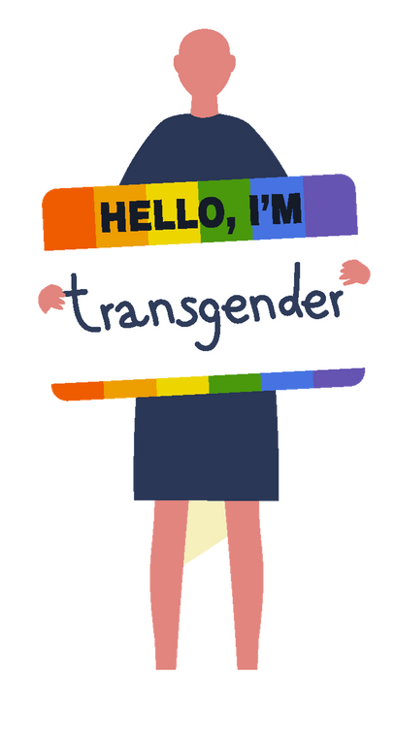
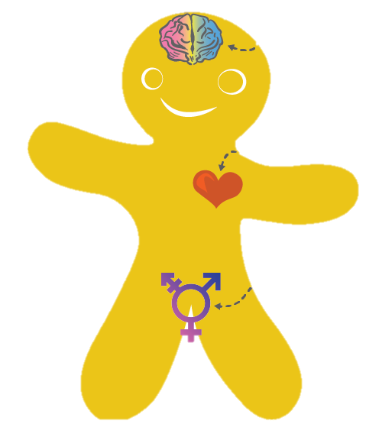
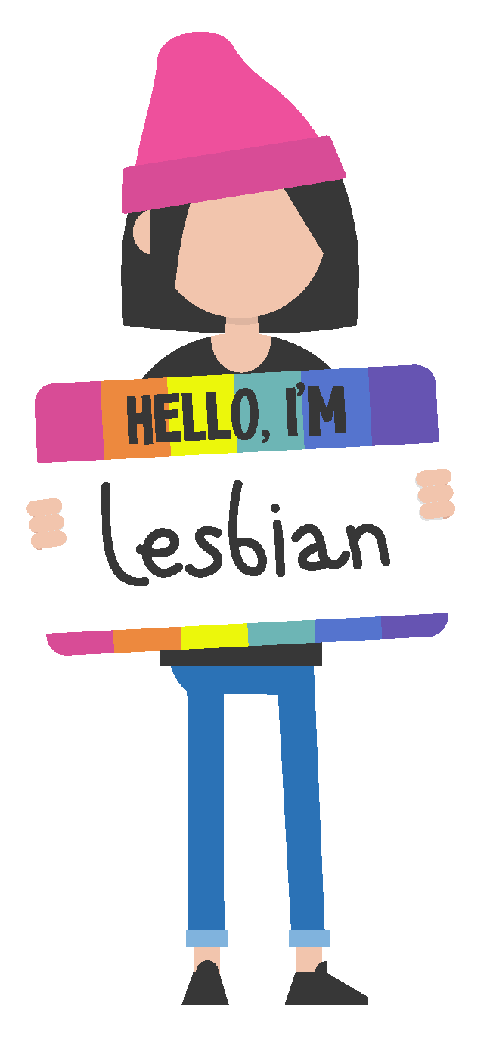
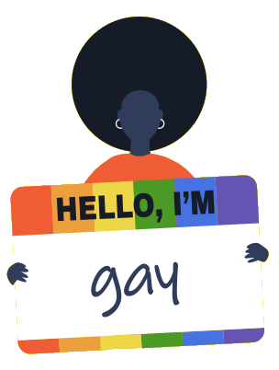
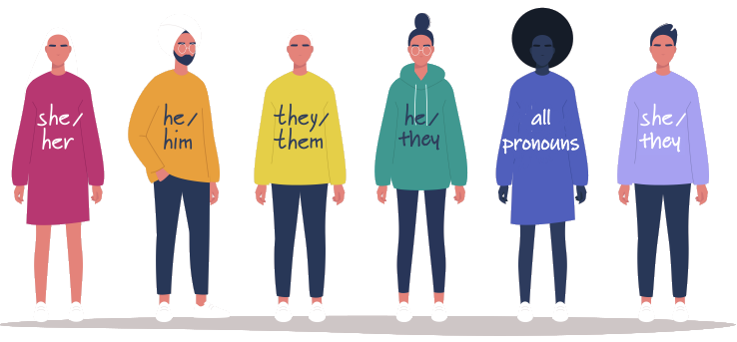
Review:
Gender Awareness
Notes:
Image Credit: Nadia Snopek, Shutterstock; genderbread.org

Slide 7
Biological
Sex
Gender
Identity
Gender Expression
Reproductive organs
Genes
Hormones
Sense of self
Personal experiences
Likes and dislikes
Style
Behavior
Appearance
Hair and make-up
Man
Woman
Trans
Non-binary
Male
Female
Inter
sex
Masculinity
Femininity
Androgyny

Slide 8

Pronouns
all
pronouns
they
they
Notes:
Image Credit: Nadia Snopek, Shutterstock

Slide 9
Avoid
Practice
Assuming:
  Assuming someone’s gender identity
Misgendering:
  Using a gender pronoun to call someone that is incorrect
Ask someone:
  “What are your pronouns?”
Use gender neutral language:
    “Greetings everyone”
    “Hello friends”
all pronouns
they
they

Slide 10
Review:
Healthy Relationships
Notes:
Image Credit: Freepik.com

Slide 11
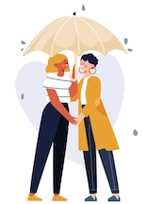
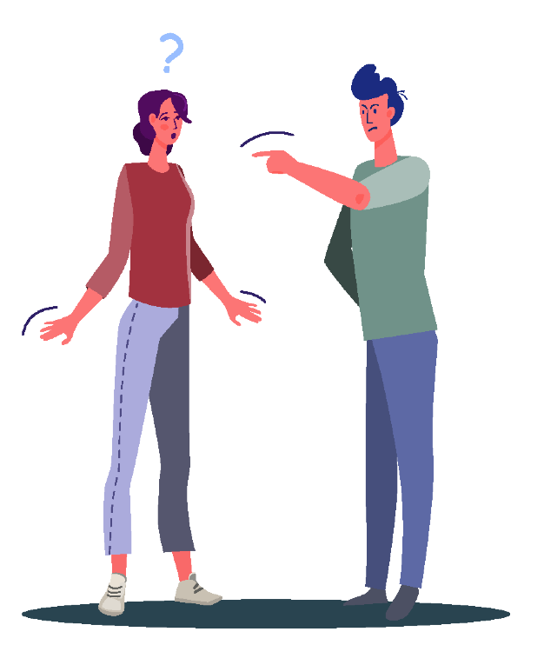
Communication
Romantic
partner
Friend
Respect
Equity
Family
Teacher
Notes:
Image Credit: Freepik.com

Slide 12
Sexual Orientation
lesbian
gay
queer
heterosexual
asexual
pansexual
Notes:
Image Credit: Nadia Snopek, Shutterstock

Slide 13
All Relationships Require Boundaries
Boundaries
Trust
Self-Care
Shared
Responsibility
Open
Communication
Consent
Honesty
Support

Slide 14
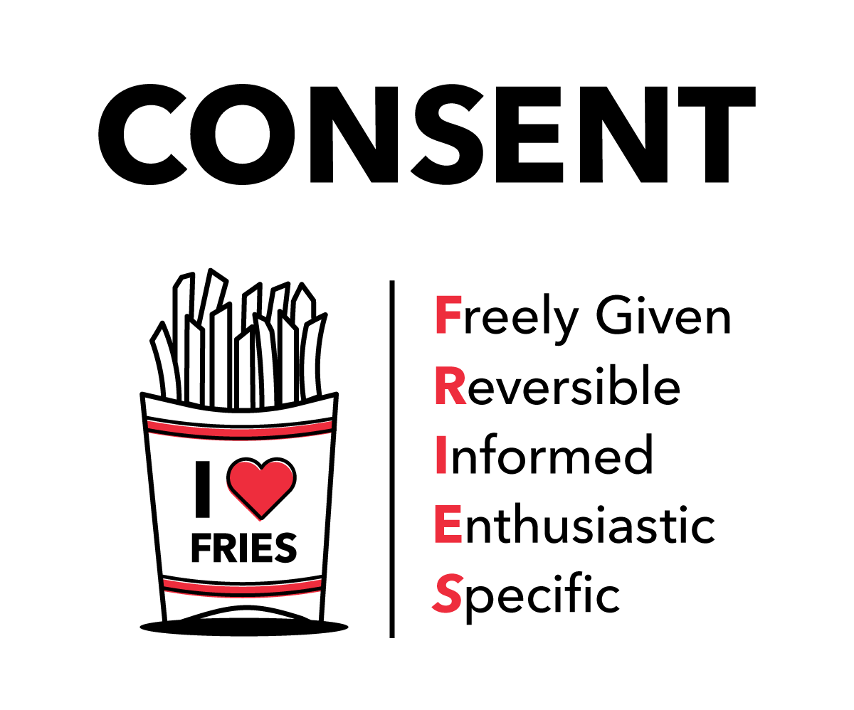

Notes:
Image Credit: Freepik.com; Planned Parenthood

Slide 15
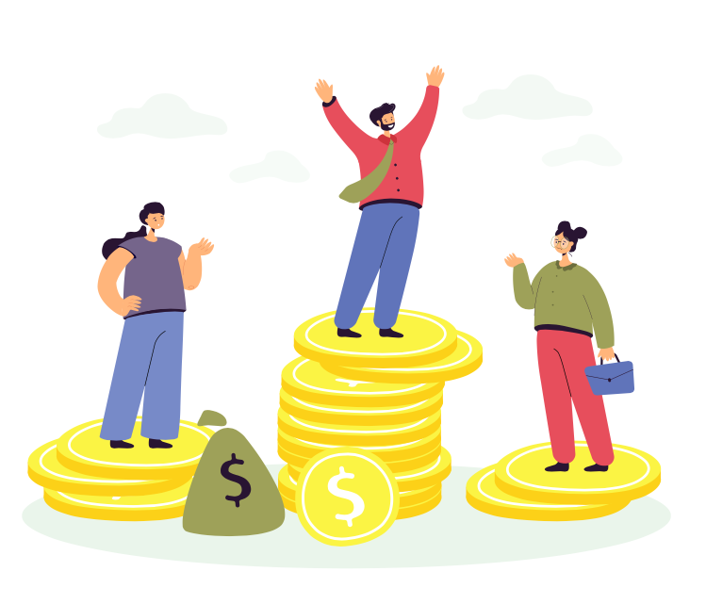
Part 3:
Gender in Today’s Society
Notes:
Image Credit: Freepik.com

Slide 16
How would you describe yourself in 3 words?

Slide 17

Notes:
Video Credit: Amaze.org, YouTube

Slide 18
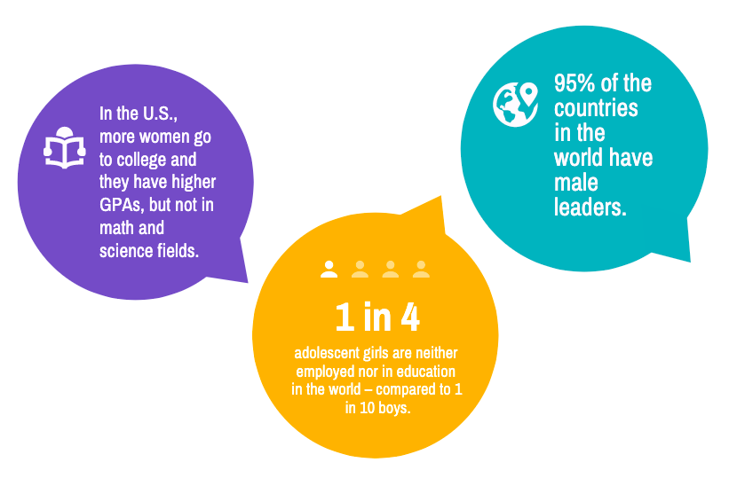
Gender Inequality

Slide 19
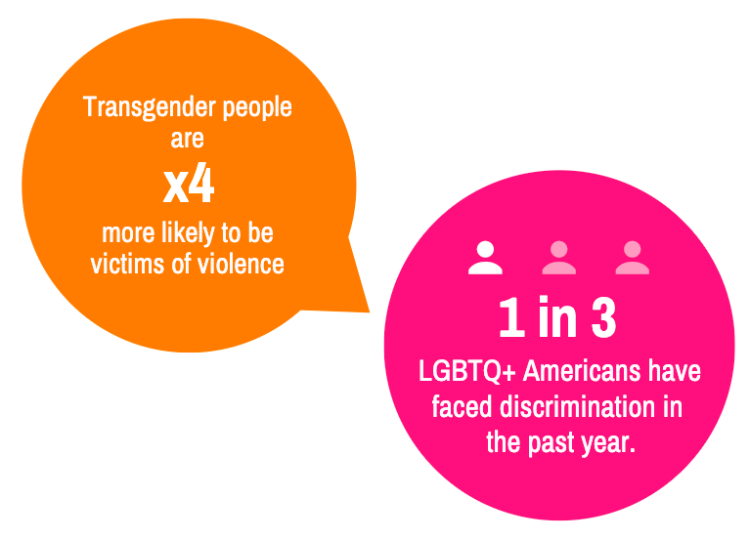
Sexuality Inequality

Slide 20
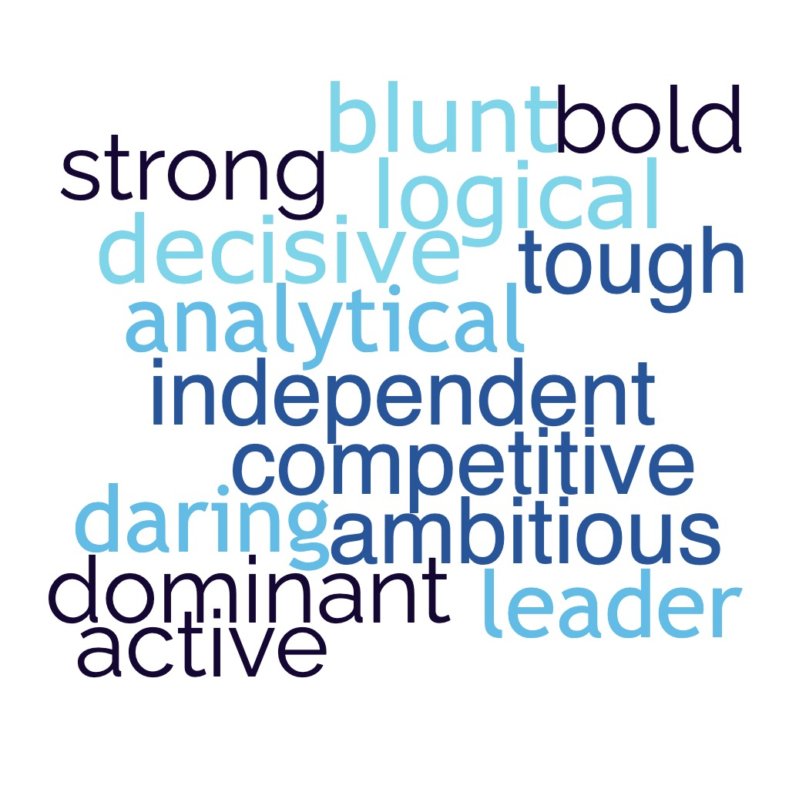
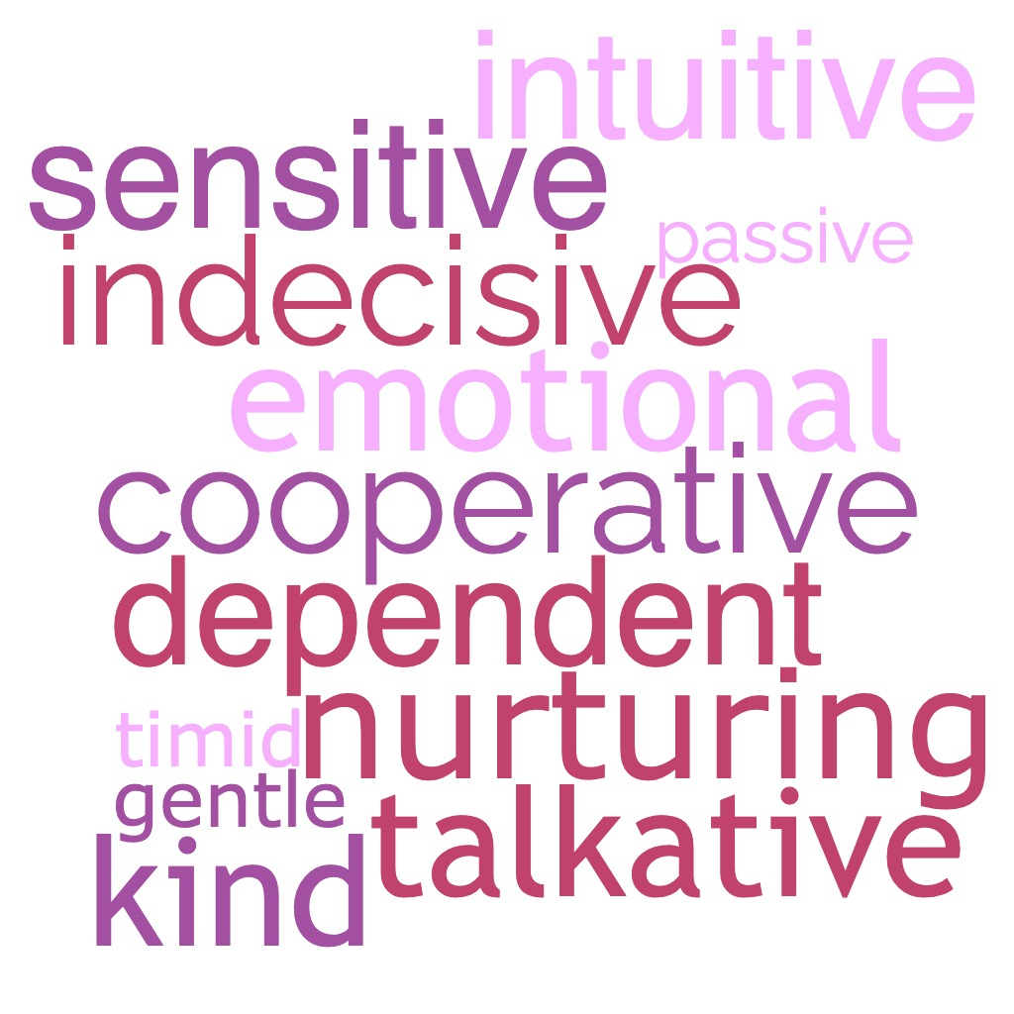
Gender Stereotypes

Slide 21
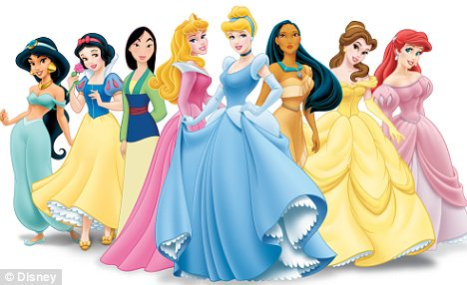
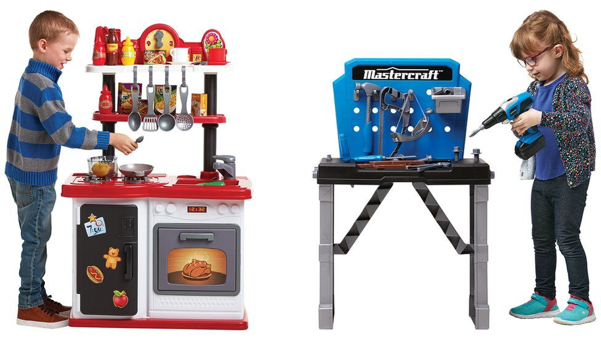
Gender Stereotypes
Notes:
Image Credit: BBC, Disney

Slide 22
Toxic Masculinity
Aggression
Dominance
Suppressing Emotions
Hyper
independence
Homophobia
Violence

Slide 23
Healthy Masculinity
Non-violence
Consent
Expressing Emotions
Responsibility
Embracing differences
Kindness

Slide 24
What can we do?
Talk about these issues!
Encourage others to challenge stereotypes
Talk to someone you trust when you witness inequality
Practice sharing your feelings
Learn to be both strong and vulnerable
Listen to the stories of people who are impacted by gender inequality and practice empathy

Slide 25
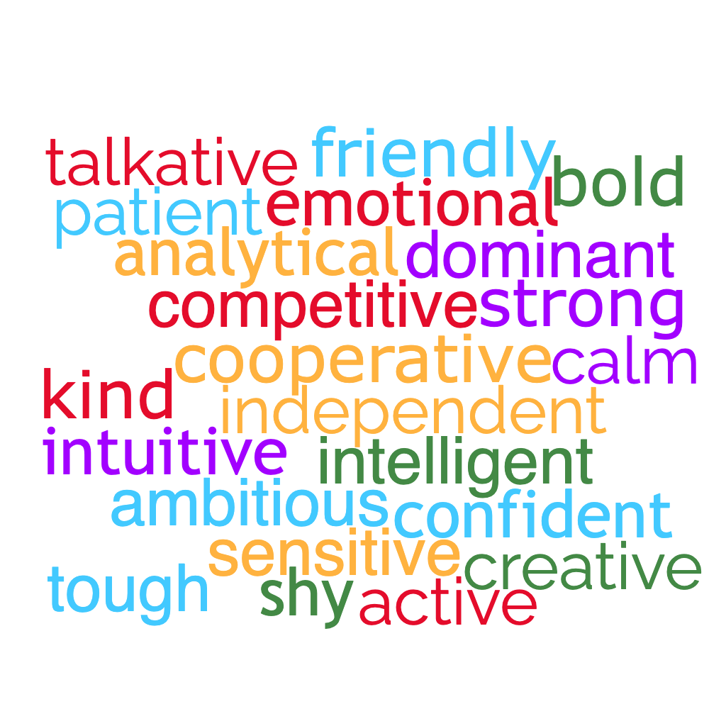

Slide 26
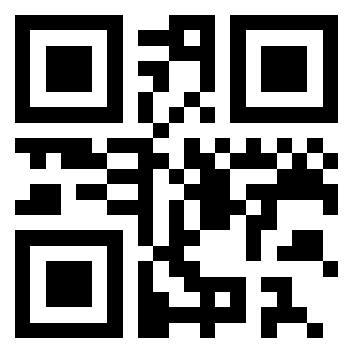

Gender in Society
Visit kahoot.it

Slide 27
1. Which of the following describes toxic masculinity?
Sharing emotions
Being peaceful
Being caring
Hiding emotions

Slide 28
2. “Boys don’t cry," ”Act like a lady" and ”Man up” are examples of _____.
Gender stereotypes
Gender equality
Misgendering
Gender identity

Slide 29
3. Where can toxic behaviors occur?
Work
School
Home
Everywhere

Slide 30
4. What is an example of healthy masculinity?
Manipulating someone
Being controlling
Having empathy
Being judgmental

Slide 31
5. What can we do about gender stereotypes and inequality?
Talk about gender issues
Challenge gender stereotypes
Practice sharing your feelings
All of the above

Slide 32
Conclusion
Thank you for your amazing participation!
Notes:
Script: Handout distributed

